Slide 1
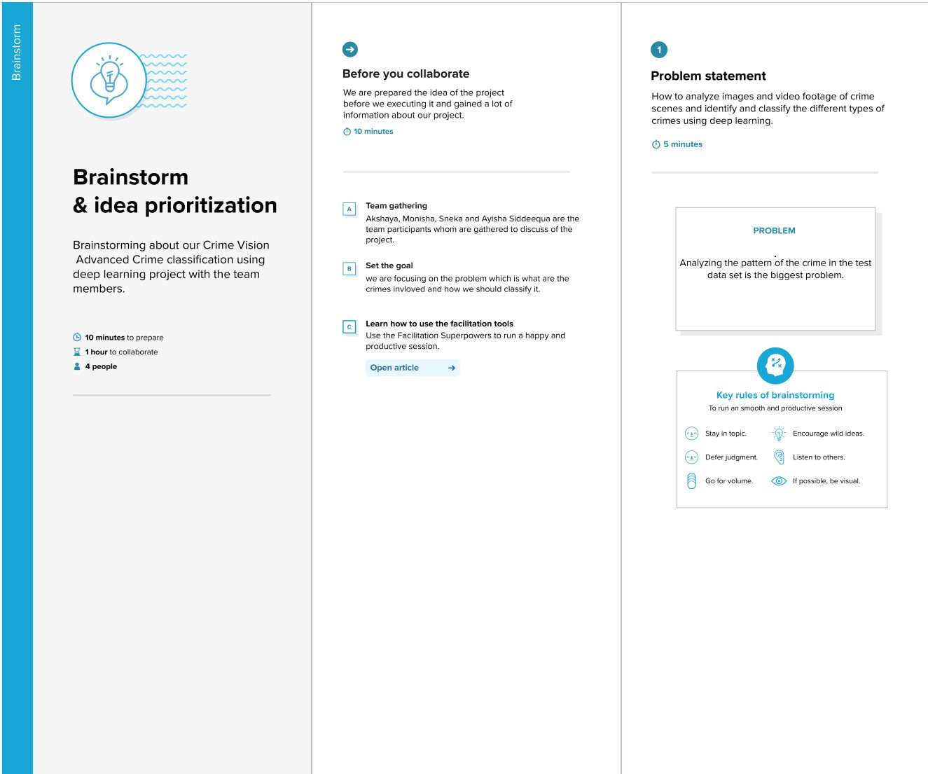
Ideation Phase Brainstorm & Idea Prioritization
Date | 25 may 2023
Team ID | NM2023TMID11400
Project Name | Automated whether classification using transfer learning
Maximum Marks
Brainstorm & Idea Prioritization Template:
We are brainstormed by analyzing the pattern to identify the different types of crime. The patterns may be the fatal or non-fatal weapon, situations and environment, positions of the non-fatal weapons, objects involved in the crime and the person involved in the images or video footages of the crime. Analyzing and identifying the victim and criminal from the images.
Step-1: Team Gathering, Collaboration and Select the Problem Statement

Slide 2
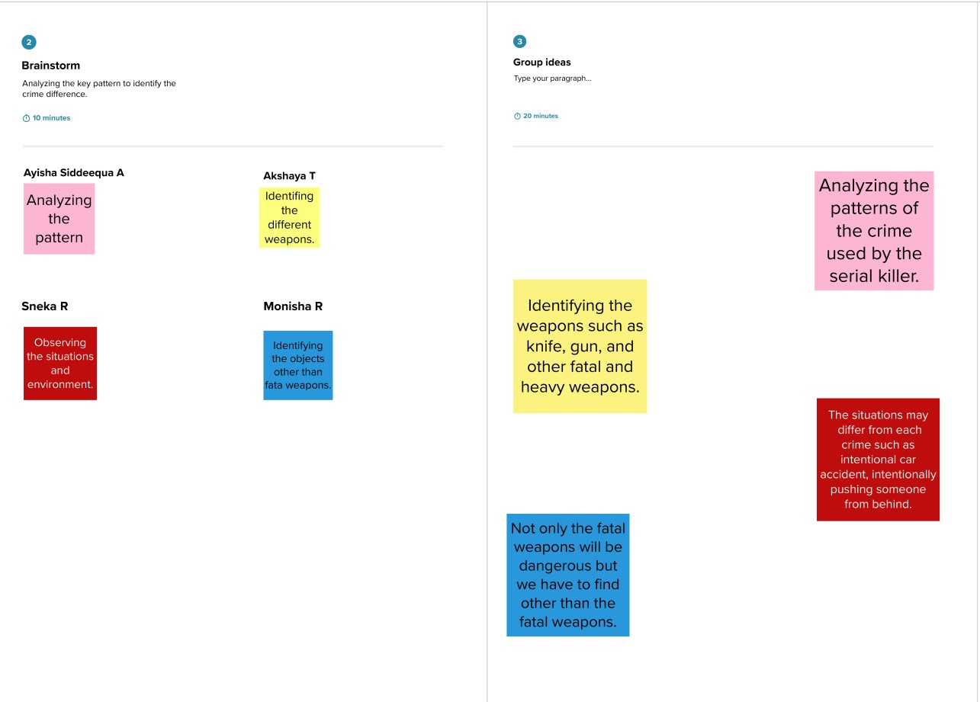
Step-2: Brainstorm, Idea Listing and Grouping
Step-3: Idea Prioritization

Slide 3
